Slide 1
Internet of Things EE701 UGV Robot for Remote Soil Health Sensing
Ujwal Waghray 50560587

Slide 2
Why I Chose IoT as My Elective
Electronics Undergrad Foundation: My undergraduate degree in Electronics gave me strong fundamentals in embedded systems, sensors, and low-level hardware.
Robotics Requires Hardware-Software Fusion: Contemporary robots hinge on a tight feedback loop between low-level actuation firmware and high-level perception software; IoT coursework forced me to bridge that gap, coding “close to the metal” while architecting system-wide data flows.
IoT as a Gateway to Sensor Fusion: Working with real-time data, multiple sensor inputs, and communication protocols helped me appreciate sensor fusion, a key concept in robotics.
Real Hardware Interfacing: IoT reinforced concepts like timing, GPIO control, communication latency, and hardware limitations, all vital to building reliable robotic systems.
System-Level Thinking: Through IoT, I learned to design systems that span from sensor input → edge computing → wireless transmission → cloud/dashboard, mimicking the data flow in robotic pipelines.

Slide 3
Topics Covered in IoT Course
Microcontroller Programming: Integrated ESP8266, Arduino Nano, and Raspberry Pi with environmental sensors (DHT11, capacitive soil-moisture probes) to build edge-computing nodes.
Wireless Protocols: Implemented and benchmarked UART, SPI, I²C, Wi-Fi, ESP-NOW, and LoRa—selecting the optimal link for power budget, range, and bandwidth.
Sensor Data Processing: Parsed pulse-width signals, calculated heat-index from T & RH pairs, and streamed real-time field metrics for immediate agronomic insight.
Wireless Networking: Wi-Fi TCP transmission to Raspberry Pi- LoRa-based low-power long-range transmission.
Protocol Trade-Off Analysis: Quantified range, energy draw, latency, and throughput for each stack and mapped them to appropriate robotics/IoT scenarios.
Dashboard Visualization: Real-time data graphing using Python and Matplotlib
Practical Debugging & Testing: Serial console logs, LED indicators, hardware failovers

Slide 4
Academic Engagement via Paper Presentations
Exposure to State-of-the-Art Research Papers: We were encouraged to explore and present peer-reviewed research papers in IoT, networking, and embedded systems.
Key Benefits:
Understood real-world deployments of IoT in smart agriculture, health monitoring, and smart cities.
Analyzed architecture diagrams, sensor networks, and communication stacks used in academic prototypes.
Presentation Practice:
Improved technical communication
Learned to critique methodologies and identify improvement areas
Bridging Theory with Practice: These papers contextualized what we built in lab and helped connect classroom learning with global research trends.

Slide 5
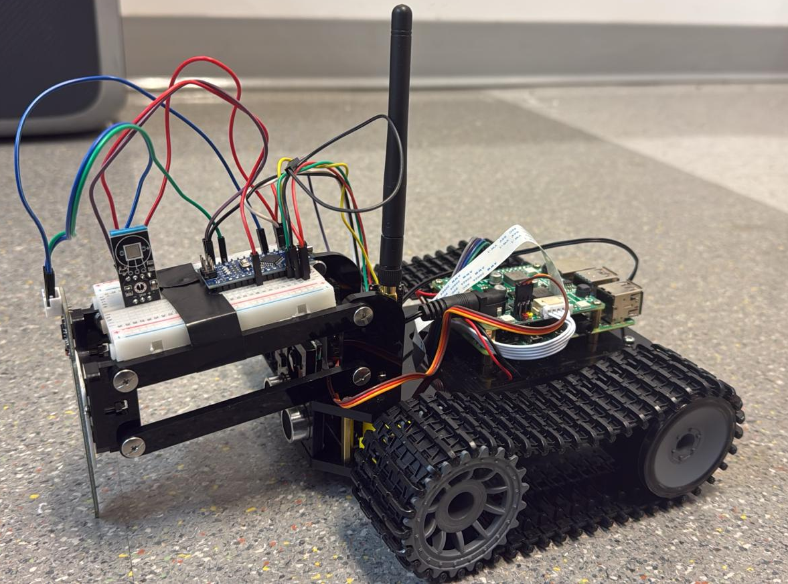
Project - Introduction
Objective:
Develop an Unmanned Ground Vehicle (UGV) for autonomous and remote sensor data collection in agricultural fields.
Key Features:
Collects environmental and soil health parameters.
Operates remotely or autonomously via GPS.
Sends real-time data to a base station.
Stores data for future analysis.
Significance:
Enhances precision agriculture.
Reduces labor in monitoring.
Provides actionable insights for crop health.

Slide 6
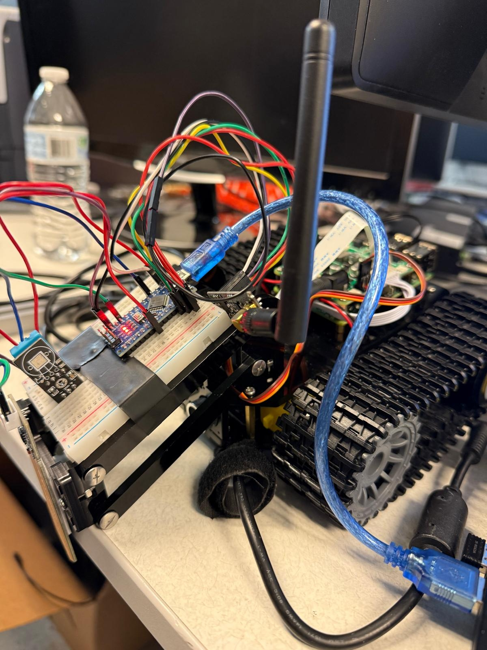
Chasis Control System
Raspberry Pi (B1): Acts as the central processing unit for the vehicle. It manages both autonomous and remote operations.
GPS Module (B2): Works with the Raspberry Pi for navigation. It allows the vehicle to function autonomously by moving to predefined GPS coordinates.
WiFi Module (B3): Enables communication with the Computer Client, allowing remote control of the vehicle.
Connections:
The WiFi Module interfaces bi-directionally with the Computer Client for remote control operations.
The Raspberry Pi engages in autonomous path planning using the GPS data for navigation.

Slide 7
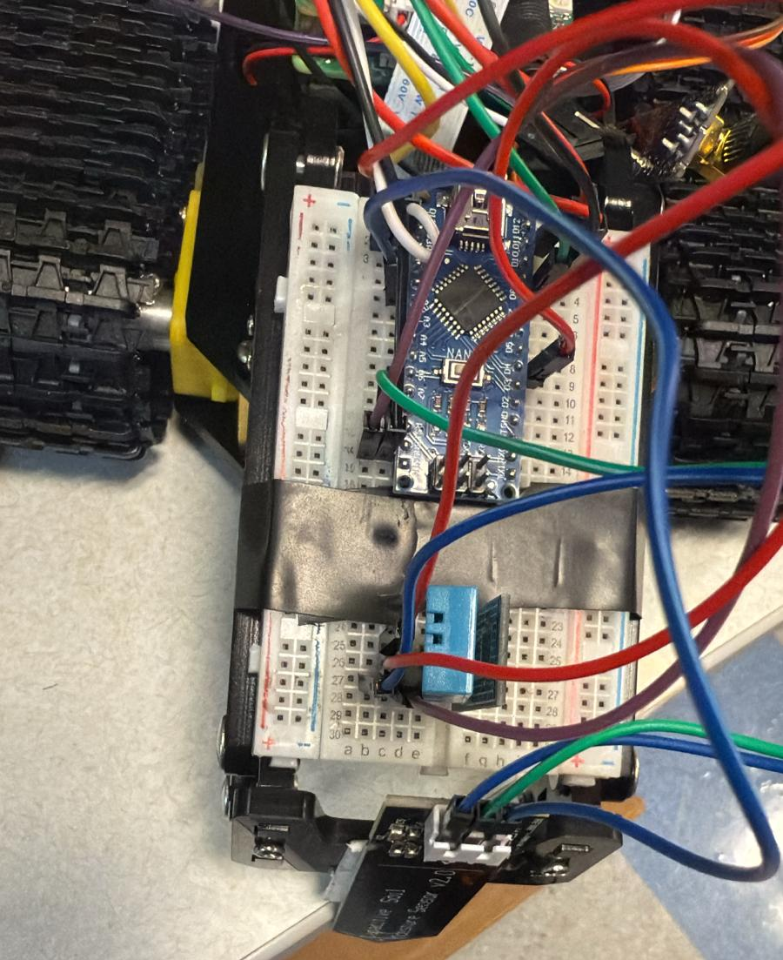
Sensor Collection System
Arduino Nano (A1): Controls local sensor operations and data collection.
Sensors (A2): Collect environmental data such as humidity, temperature, NPK, and moisture levels.
NRF24 Transmitter (A3): Sends the collected sensor data to the Base Station.
Relationships:
Integrated as part of the Chassis Control System, responsible for real-time data acquisition.
The NRF24 Transmitter communicates sensor data to the NRF24 Receiver at the Base Station.

Slide 8
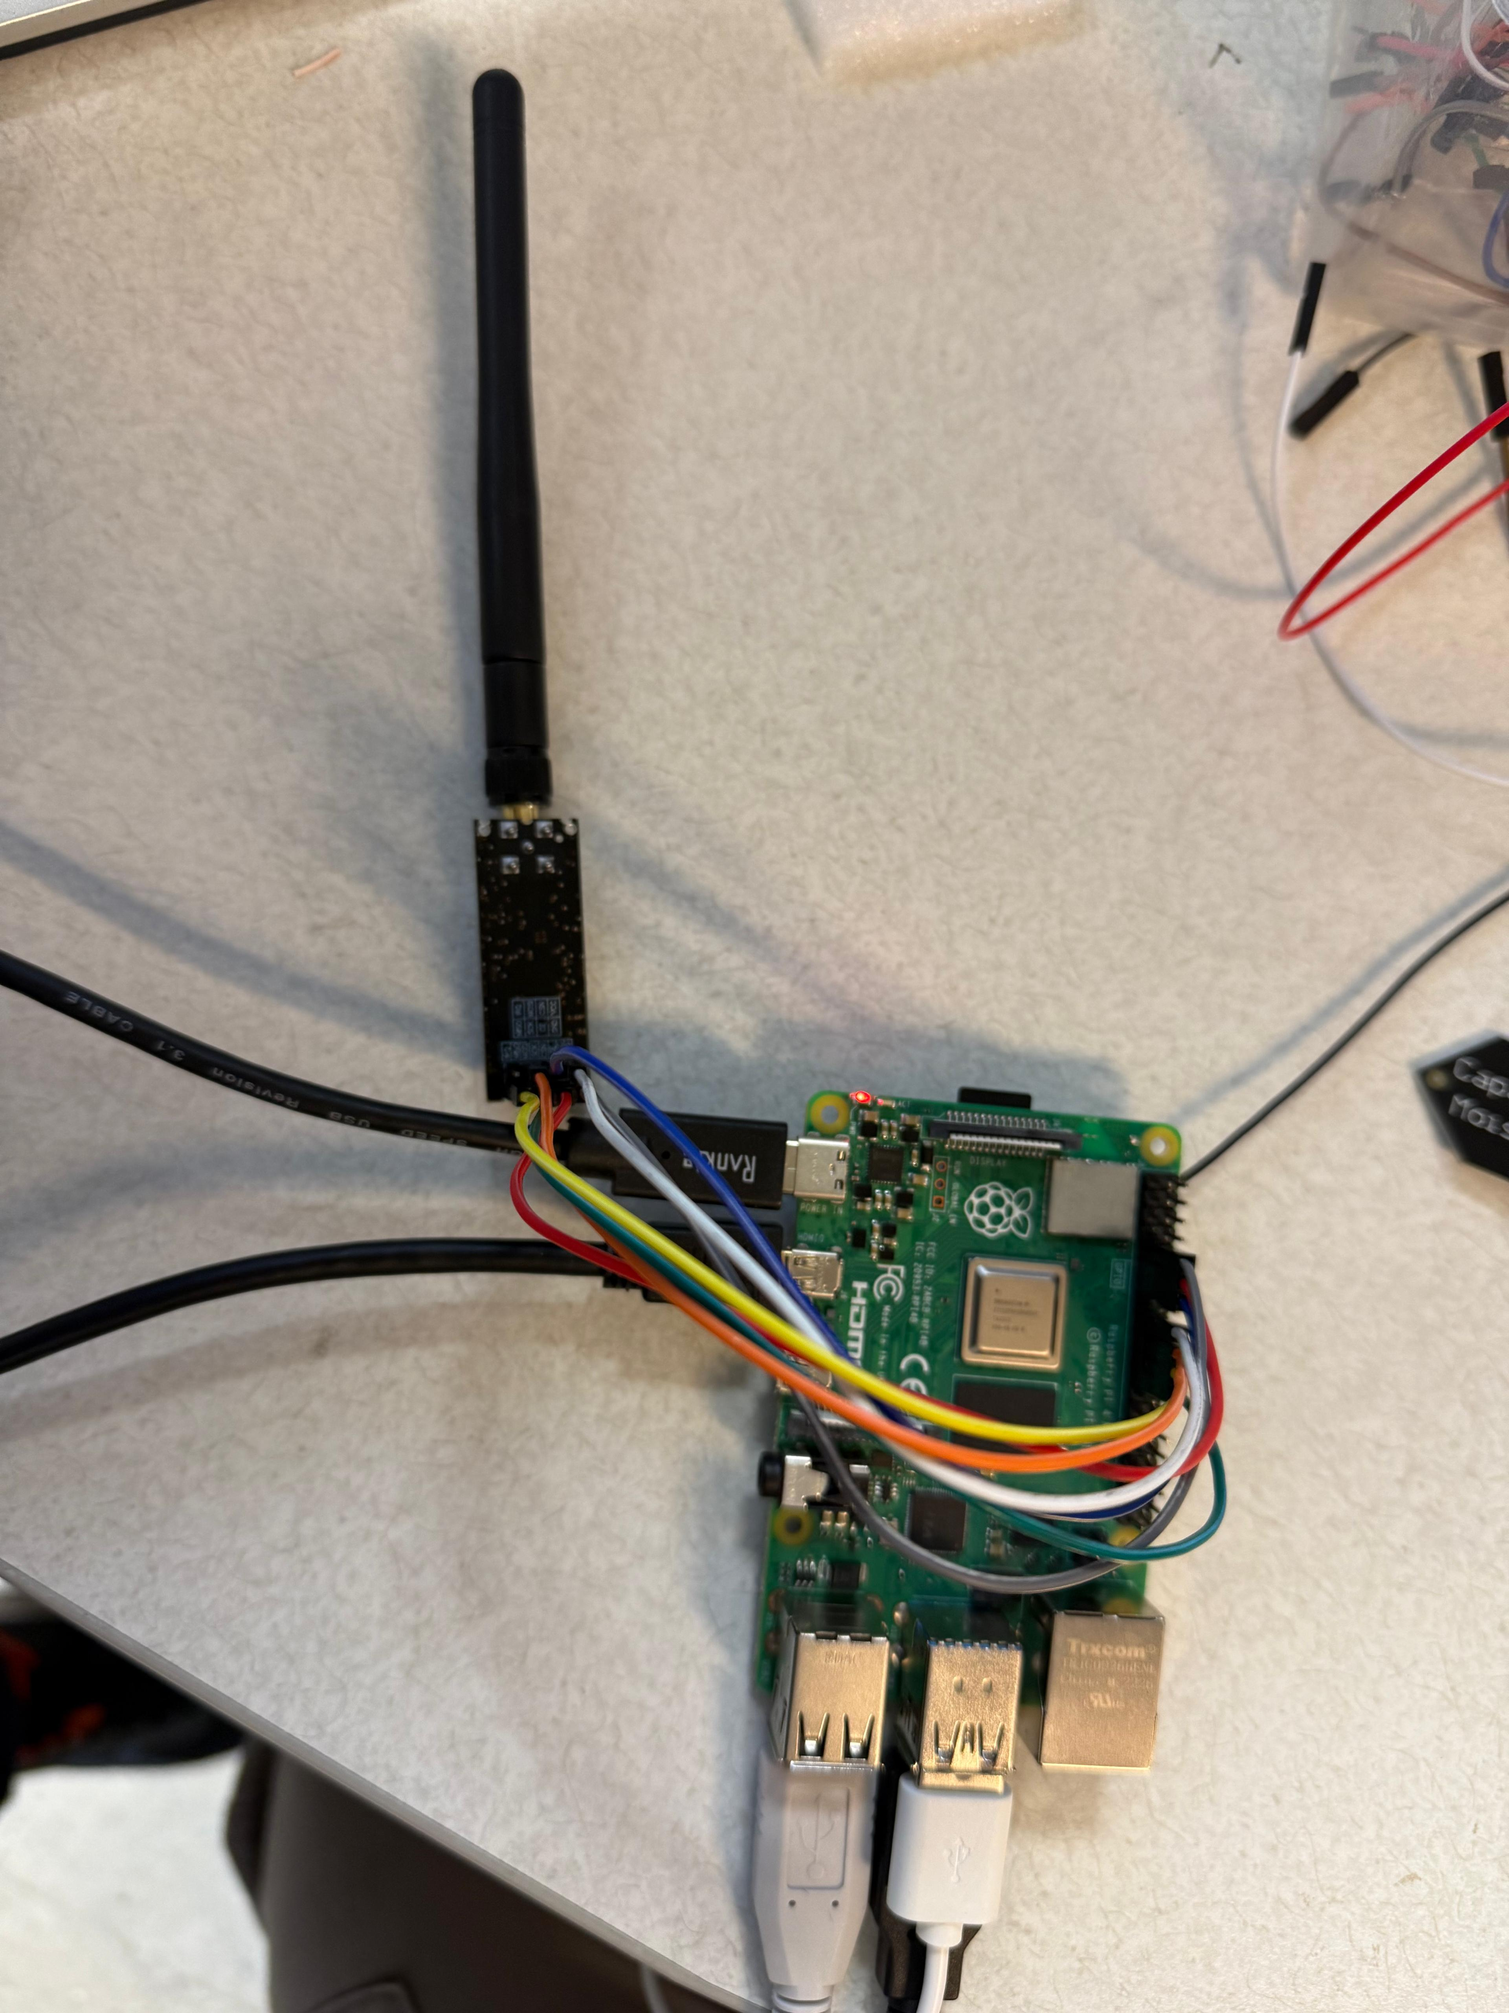
Base Station
NRF24 Receiver (C1): Receives data from the Sensor Collection Module's NRF24 Transmitter.
Dashboard System using Matplotlib (C2): Visualizes and graphs the incoming data for user interpretation.
Storage (CSV) (C3): Stores the collected and processed data for future reference and analysis.
Workflow:
The NRF24 Receiver transmits data to the Dashboard, which displays it graphically.
Data is archived in the form of CSV files for longitudinal analysis.

Slide 9
Computer Client
Remote Control Interface (D1): Provides user interaction for controlling the UGV operations over WiFi.
WiFi Communication: Facilitates direct communication between the Remote Control Interface and the Chassis Control System, enabling real-time remote vehicle control.
Integration
Sensor Data Flow: Starts at the Sensors, moves through the Arduino Nano, and reaches the Base Station via the NRF24 Transmitter and Receiver setup.
Autonomous Operation: The GPS Module supports the Raspberry Pi in navigating autonomously via path planning algorithms.
Remote Operation: WiFi connectivity enables the Computer Client to manipulate vehicle actions remotely.
This structured interaction between modules allows your unmanned ground vehicle to efficiently collect agricultural data, function autonomously, and provide actionable insights through remote interfaces.

Slide 10
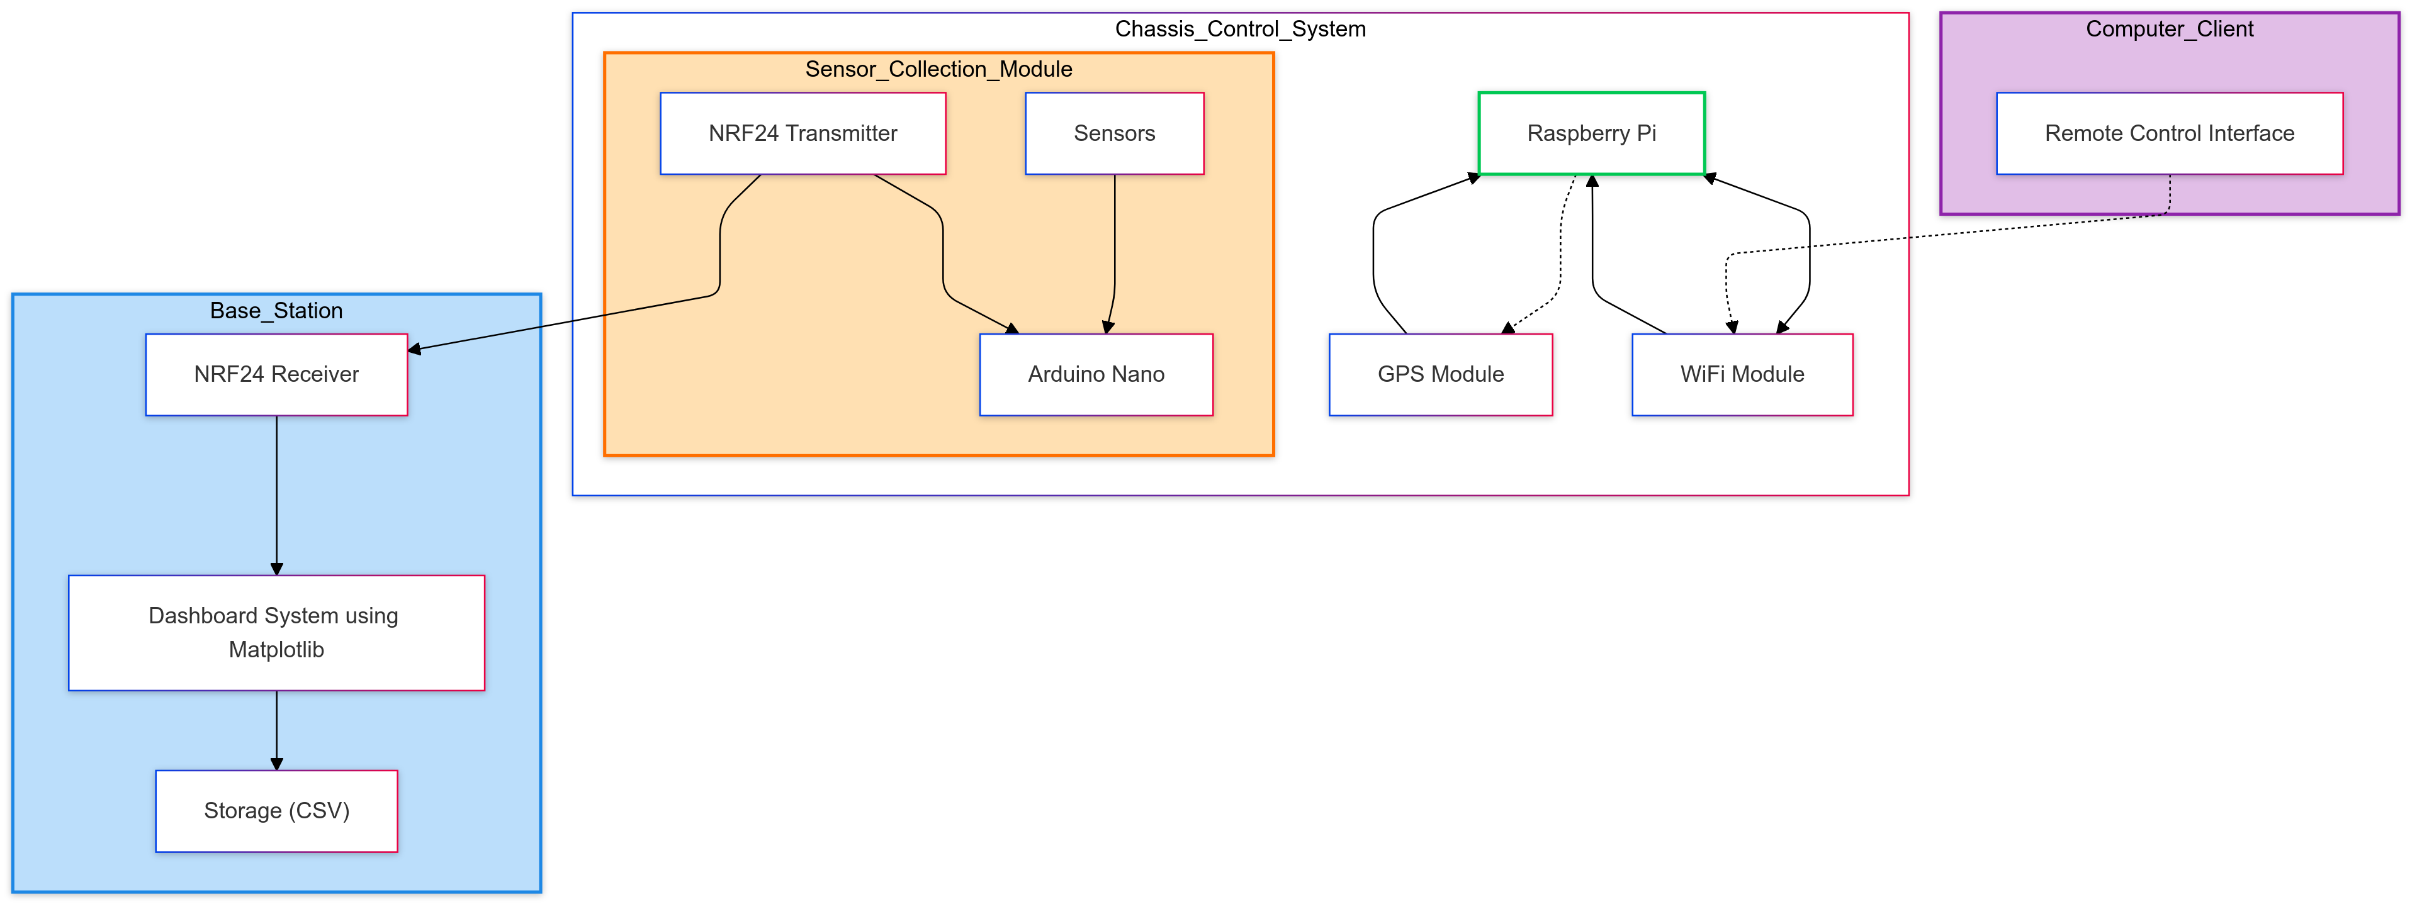
Block Diagram

Slide 11
Devices
Raspberry Pi: A compact, versatile single-board computer used as the central processing unit for the UGV. It manages autonomous operations through GPS-based navigation and enables remote control via WiFi. With its powerful processing capabilities, the Raspberry Pi handles tasks such as path planning and coordinating data exchange between the UGV and the Computer Client.
Arduino Nano: A lightweight and energy-efficient microcontroller that manages the Sensor Collection Module. It collects data from multiple sensors, processes it locally. Its small size and low power consumption make it ideal for embedded sensor applications.
DHT11 Sensor: A digital sensor that measures temperature and humidity. It uses a resistive humidity sensing component and a thermistor for temperature measurement, providing accurate and reliable environmental data.
Soil Moisture Sensor: A critical tool for measuring the moisture content in the soil. This sensor outputs data offering insights into soil health and helping to guide irrigation decisions.
NRF24L01 Wireless Module: low-power 2.4 GHz RF transceiver that enables wireless communication between the Sensor Collection Module and the Base Station. The NRF24 transmits sensor data efficiently over long distances, ensuring reliable data transfer in field conditions.
Computer Client :A remote interface used for controlling the UGV over WiFi. The client simplifies UGV management, offering an intuitive and responsive user experience.

Slide 12
Output at the Sensor Collection Module
Soil Moisture Data:
Two soil moisture readings (SoilMoisture1 and SoilMoisture2) are transmitted.
These values represent the moisture levels in the soil, derived from the connected soil moisture sensors.
Temperature Data:
The temperature data is collected from a connected temperature sensor (e.g., DHT11) and transmitted as a floating-point value.
It is formatted for easy processing and visualization.
Humidity Data:
Humidity readings are captured and transmitted, representing the relative humidity in the environment.
Data Packet Format:
The transmitted data is packed into a 12-byte array with the following structure:

Slide 13
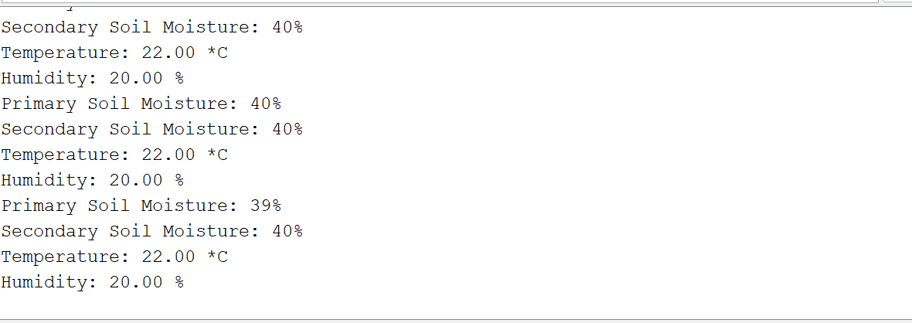
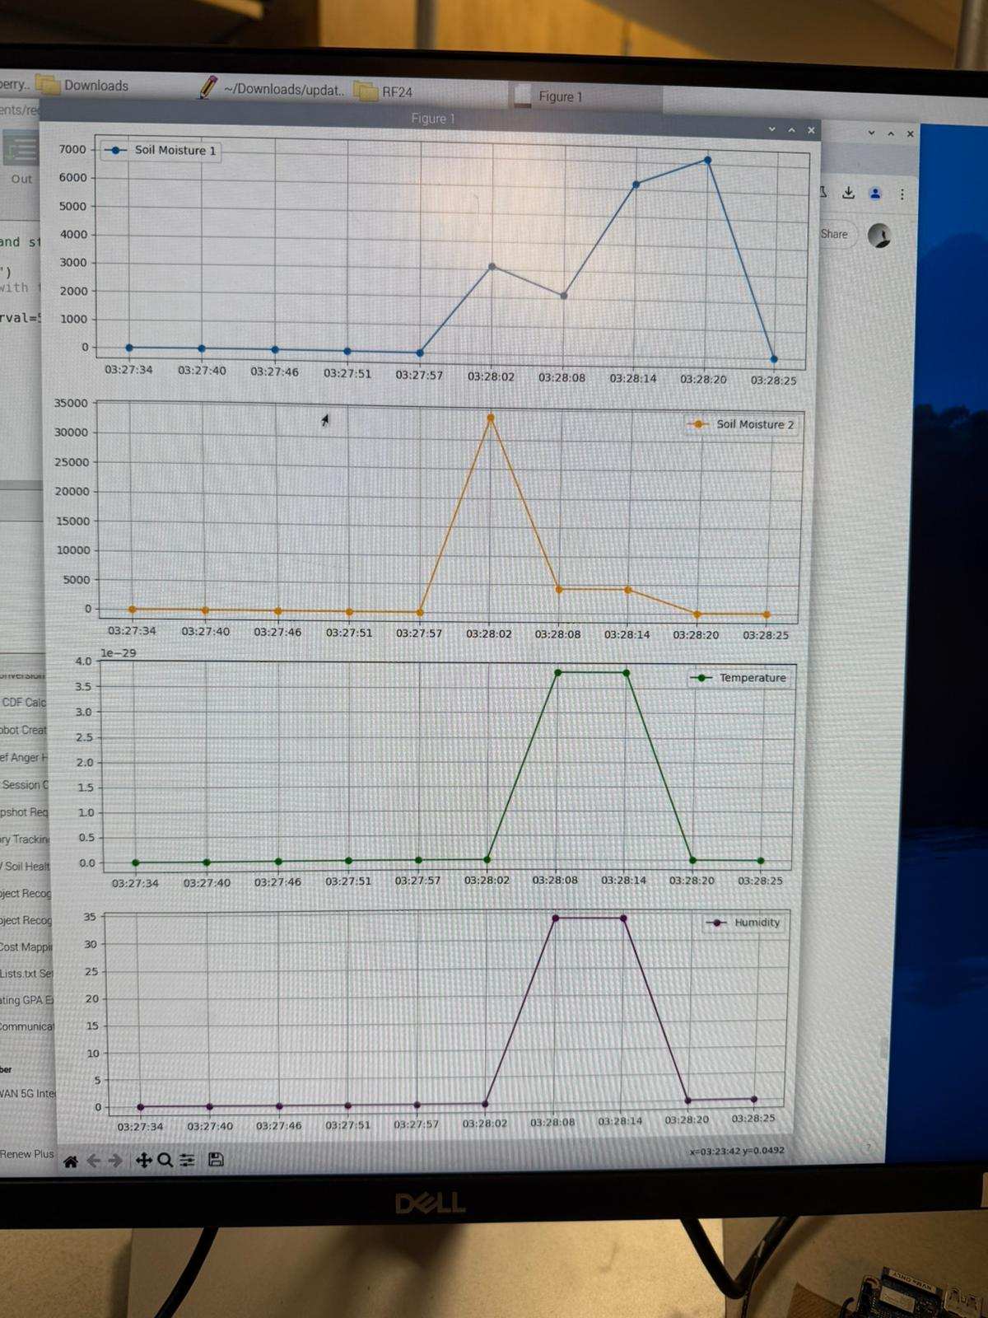

Slide 14
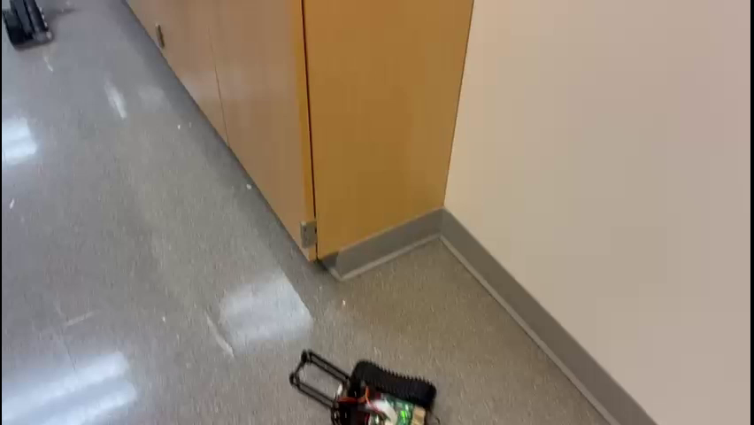

Slide 15
Output at the Base Station
Real-Time Graphs:
The base station displays data in a visually intuitive dashboard created using Matplotlib.
Graphs include:
Soil Moisture Levels: Two line graphs for SoilMoisture1 and SoilMoisture2, updated in real-time.
Temperature: A continuous plot reflecting temperature changes.
Humidity: A dynamic graph showcasing variations in humidity.
Data Readability:
The graphs are clearly labeled with axes for time and corresponding measurement values.
All plots refresh periodically to reflect the most recent readings from the sensors.
Alerts and Indicators (Optional):
Thresholds can be set for soil moisture, temperature, and humidity to indicate warnings or actionable events

Slide 16
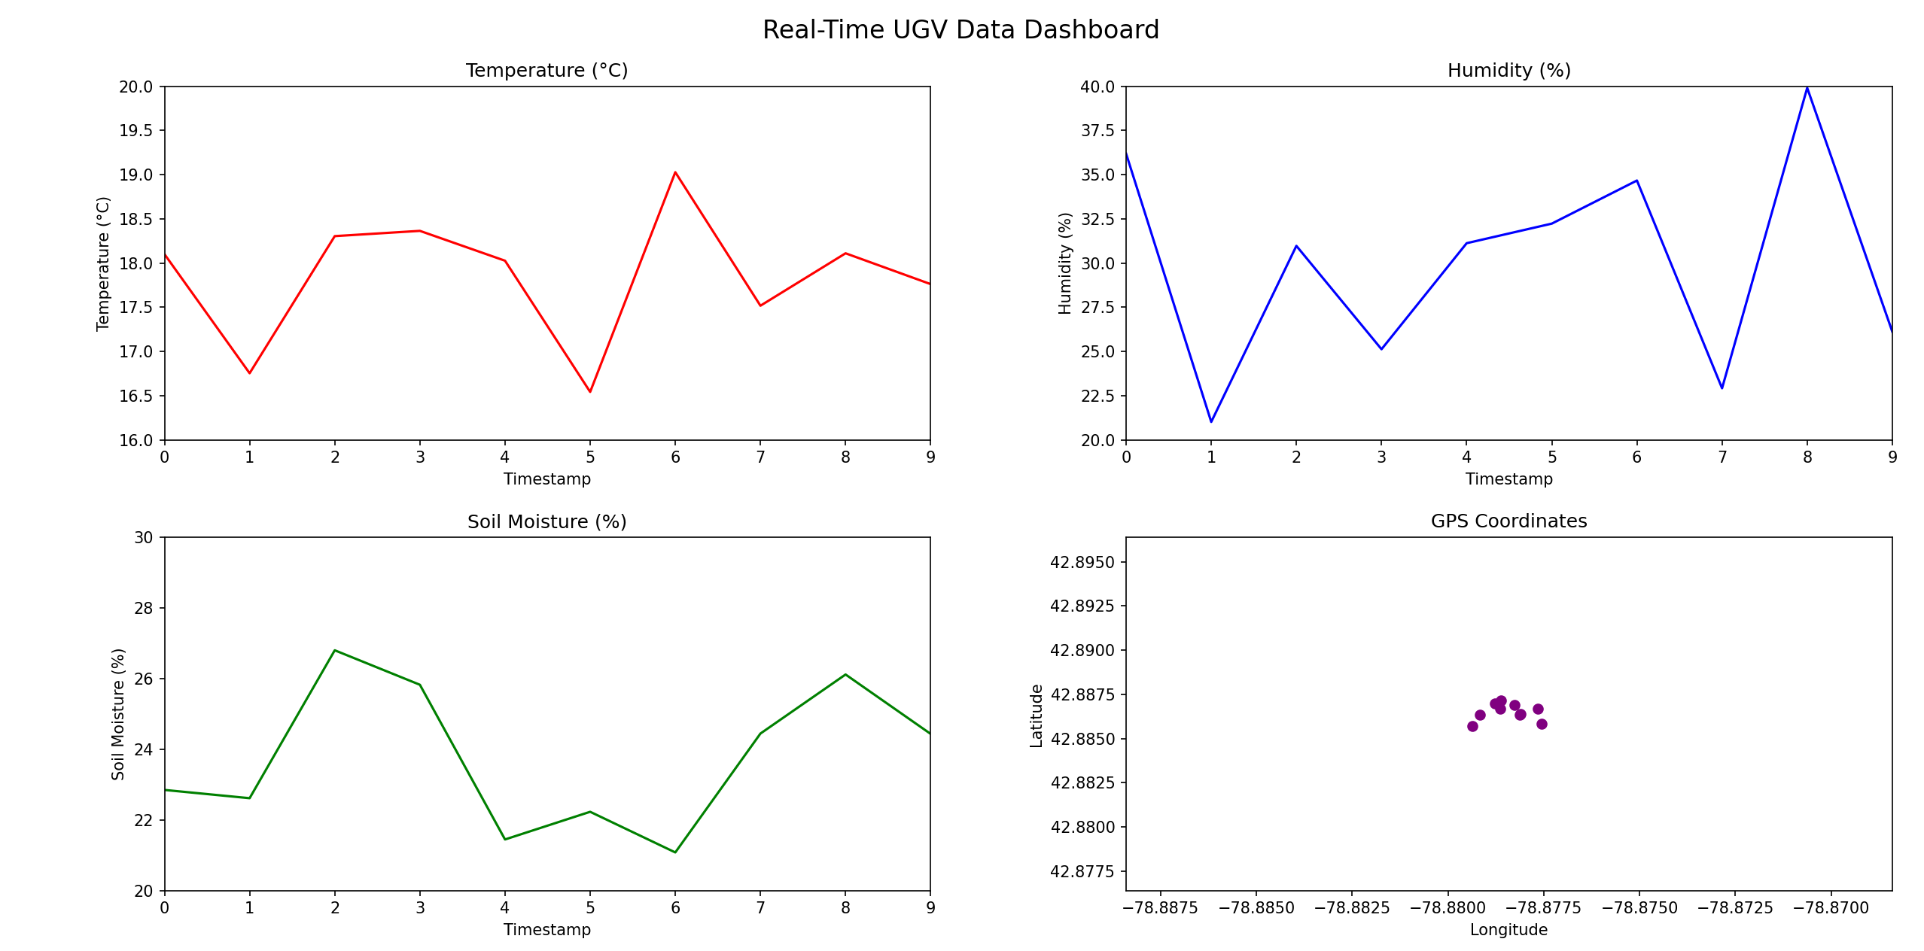
Results
We managed to create and dashboard using pythona and can visualise data in evey 5 secs.
the change in temperature is given by a spike and th realtime soil moisture changes can be visualised.

Slide 17
What Went Right :)
Sensor Data Collection (Arduino Nano):
Sensors accurately collected data (soil moisture, temperature, humidity).
Data was transmitted reliably via the NRF24 module.
Dashboard (Raspberry Pi):
Real-time data visualization using Matplotlib.
Data stored in CSV format for future analysis.
Remote Control (Computer Client):
Remote control of the UGV via WiFi worked seamlessly.
Stable bi-directional communication enabled smooth operation.
The system effectively collected, visualized, and stored sensor data while allowing remote control of the UGV.

Slide 18
What Went Wrong :(
GPS Module:
Initially worked but stopped functioning after a while, causing issues with autonomous navigation.
Path planning algorithms could not be implemented due to the GPS malfunction.
NRF Data Transmission:
Data transmission through the NRF24 module worked initially, but later failed due to issues with the data format.
Inconsistent transmission led to gaps in data collection.
Cloud Data Upload:
Data intended for cloud upload did not work as planned.
The integration for cloud storage failed, preventing remote access to stored data.

Slide 19
Next Steps
Fix GPS Module:
Investigate and troubleshoot the GPS module to ensure reliable functionality for autonomous navigation.
Reimplement the path planning algorithms once the GPS is stabilized.
Resolve NRF Data Transmission Issue:
Revisit the data format for NRF24 communication to ensure compatibility.
Test and calibrate data transmission to avoid data loss and improve reliability.
Implement Cloud Data Upload:
Integrate a reliable cloud solution (e.g., AWS, Google Cloud) for storing and retrieving sensor data.
Ensure smooth data flow from the base station to the cloud for remote access.
Expand Autonomous Capabilities:
Once GPS issues are resolved, focus on fine-tuning the autonomous navigation and path planning algorithms.
User Interface Enhancements:
Improve the dashboard and Computer Client interface for more intuitive control and real-time monitoring.

Slide 20
thank you

